Slide 1
TCP Brownbag

Slide 2
Cortana
Observations
Click
Text
Core UX / Agent
Cortex
Speech
Vision
Skills
Skills
Event
Skills

Slide 3
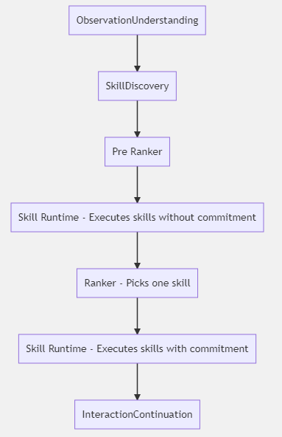
Cortana - Cortex

Slide 4
Output Mappers
Dmitriy Chernyak
How do output mappers work, in particular, how do the data flow from TCP to client using output mappers?
Why are there restrictions in outputmappers, such as a different logger and different access to flights/tenant config? Can we unify this?
What does the code in the SnR layer do, and why is it needed? Will this exist in the new stack?
Can we improve the documentation, or perhaps have better self documenting code, for basic outputmapper use? The naming in the code is so generic, that nobody has any idea what it does (*Sample 1)
When do we need an output mapper? Is it ONLY for showing UX, or should all task forms have them?
When should we write custom output mappers vs. use the ones from the core team? Ex. CortanaSPAIdentityResponseGenerator?

Slide 5
Output Mappers
Dmitriy Chernyak
After we receive a request and do skill logic, we need to return a response to a user.
In TCP, this is done with a Dialog Act.
A Dialog act has three main parts:
What Cortana says (LG)
What Cortana shows (Response / Adaptive Cards)
What Cortana does (Actions)
A Dialog act can also not result in a response to the user (e.g. by chaining to another skill)

Slide 6
Output Mappers
Dmitriy Chernyak
The Output Mapper is the part of the dialog act that produces dynamic parts of the response.
Today, that is mainly the response / adaptive cards and the actions and can also include task chaining.

Slide 7
Output Mappers
Dmitriy Chernyak
If your response to the user has no dynamic parts, you don't need an Output Mapper and can leave it null (or unset)*
We will automatically provide a default no-op Output Mapper for you (CortanaSPAIdentityResponseGenerator)
If you want a custom dynamic repsonse, you will need to write your own OutputMapper.
*As soon as Dmitriy checks in a PR which is already written and signed off on

Slide 8
Output Mappers
Dmitriy Chernyak
Cortex
Xap
SnR
Cortex packages the skill's response in a structure called an Ado Container, which is sent through Xap and is unpacked in SnR
SnR uses the bond response object to build an HTML UX to display.
In the future, we hope to move most UX to use Adaptive Cards, which do not require custom SnR code.

Slide 9
Parameters
Yuyu Zheng
How does parameter state management work, such as ‘filled’, ‘prompted for value’, etc…
There are two sets of parameter states in TCP:
Cortana.TaskCompletion.Data.State (Enum in Parameter.cs)
Cortana.CU.Entity.State (Bond Cortana.CU.Entity.State.bond)
The first one is only used in the TFI for resolvers.
The parameter states you see in the logs and people usually refer to is the second one Dialog entity state.
Notes:
https://msasg.visualstudio.com/Cortana/_search?text=parameter.cs&type=code&lp=code-Project&filters=ProjectFilters%7BCortana%7DRepositoryFilters%7BCore%7D&result=DefaultCollection%2FCortana%2FCore%2FGBmaster%2F%2Fruntime%2Fservices%2FReactiveHost%2FFunctorInterface%2FData%2FParameter.cs&_a=contents

Slide 10
Parameters
Yuyu Zheng
Parameter state | Description | When does a parameter have this state | Associated Dialogacts | Accepted state of input parameter
None | Initial state indicating the value of the parameter is empty | Every parameter is initiated as None state. Resetting a parameter | MissingValue | Yes for optional parameter only
Filled | Value of the parameter is set and accepted. | Resolution of the parameter has completed, and the output has been incorporated | ParameterFilled | Yes
Resolved | A resolver has operated on this parameter but the output has not been incorporated | Resolution of the parameter has completed | N/A | No
FilledWithEmptyValue | A resolver has operated on this optional parameter but the output is empty | Resolution of the optional parameter has completed | N/A | Yes for optional parameter only
ResolutionError | Indicates the resolution failed | Resolver throws an exception Resolver explicitly builds an error response | ResolverFailure | No
ClientResolutionRequested | Request client resolution to be performed on this parameter | Client resolver finishes running, and client data is needed | ResolverInProgress | No

Slide 11
Parameters
Yuyu Zheng
Parameter state | Description | When does a parameter have this state | Associated Dialogacts | Accepted state of input parameter
PromptedForValue | The resolution of the parameter needs user input to continue | All input LU slots associated with this parameter are missing. Resolver has run but does not set a value | MissingValue | No
PromptedForConfirmation | The value of the parameter needs user confirmation | The parameter’s value is set and there is a Confirmation dialogact desfined in Taskform | Confirmation | No
ConfirmationRejected | The value of the parameter has been rejected by user | User rejected the confirmation dialogact | ConfirmationRejected | No
PromptedForSelection | The value of the parameter needs user disambiguation | There are multiple values added to the output during resolution but the parameter is marked as unique | Disambiguation | No
AsyncResolutionRequested | Request Async resolution to be performed on this parameter | Async resolver finishes setting up | ResolverInProgress | No

Slide 12
Parameters
Yuyu Zheng
How to trace or debug the parameter state transition?
Take advantage of the logs in the taskcompletionservice table. We usually log a line whenever there is a state update.
Most of the state update happens in TFU (TaskFrameUpdater.cs) and DefaultPolicy (DefaultPolicy.cs). Check out the code in these two files.
Notes:
https://msasg.visualstudio.com/Cortana/_search?text=parameter.cs&type=code&lp=code-Project&filters=ProjectFilters%7BCortana%7DRepositoryFilters%7BCore%7D&result=DefaultCollection%2FCortana%2FCore%2FGBmaster%2F%2Fruntime%2Fservices%2FReactiveHost%2FFunctorInterface%2FData%2FParameter.cs&_a=contents

Slide 13







Task Form Interpreter (TFI)

Slide 14
Task Form Execution
Yuyu Zheng
How is the execution order decided for all the resolvers in a task form?
Each resolver must have one or more parameters associated with it.
One parameter is dependent on another if its input parameter is set. So parameters dependencies basically form a DAG(directed acyclic graph).
When loading the task form, tcp will do a topological sort on parameters. And then during the resolution phrase, tcp will run the resolvers based on the sorted parameters.

Slide 15
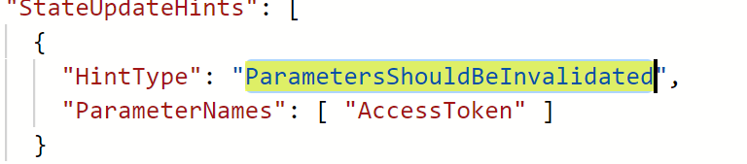
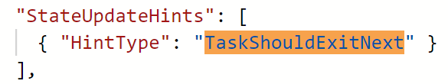
Task Form Execution
Yuyu Zheng
2. Where can we find all the supported parameters used in a task form, and how they work (like StateUpdateHints, LUConstraints )?
StateUpdateHints: Associated with dialogact, performed when the dialogact is returned to user
ParametersShouldBeInvalidated:
b. TaskShouldExitNext:

Slide 16
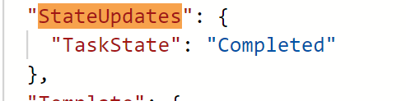
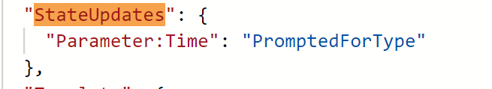
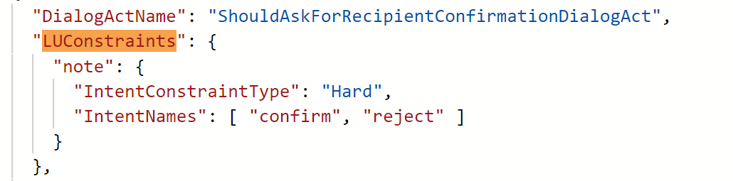
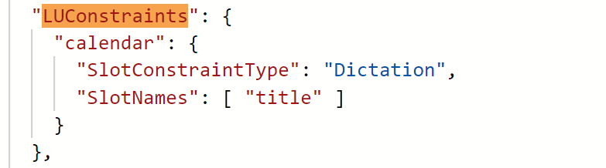
Task Form Execution
Yuyu Zheng
Stateupdates: Associated with dialogact, update the state of parameters or task
a. task state update:
b. parameters state update:
LUConstraints: Associated with dialogact, by using the LUConstraints, you can force LU to only parse the intent
and the slots specified.

Slide 17
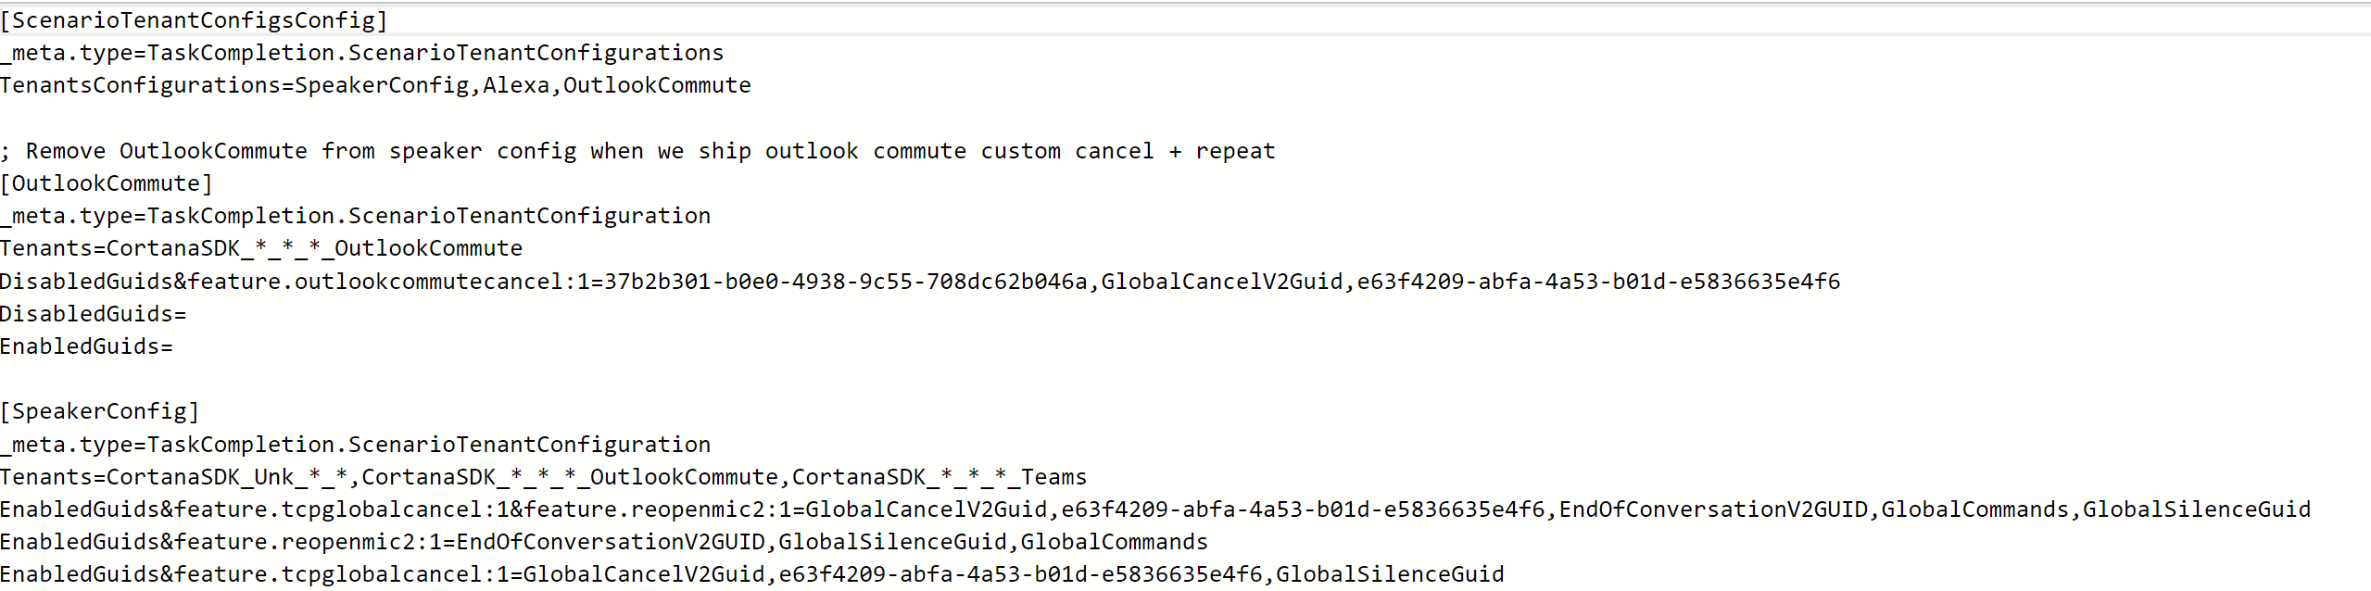
Task Form Execution
Yuyu Zheng
3. What’s the recommended way to create / maintain task forms for different endpoints?
For different surfaces, we can use tenant config to differentiate task forms.
Leverage C# authoring to improve code reusability

Slide 18
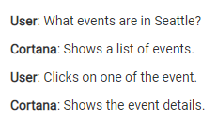
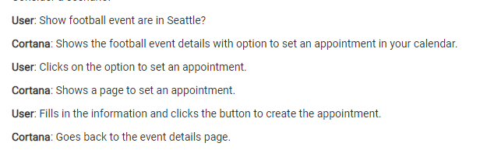
Task Form Chaining
Amritha Dilip
Where is chaining used?

Slide 19
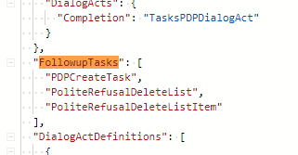
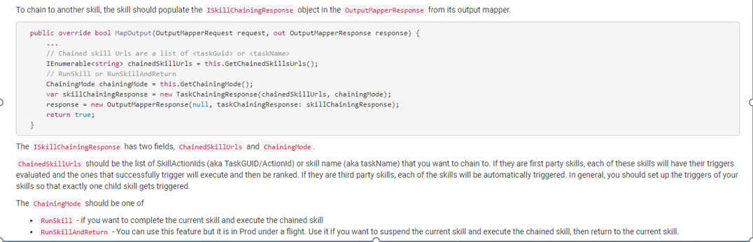
How do I chain to another skill?

Slide 20
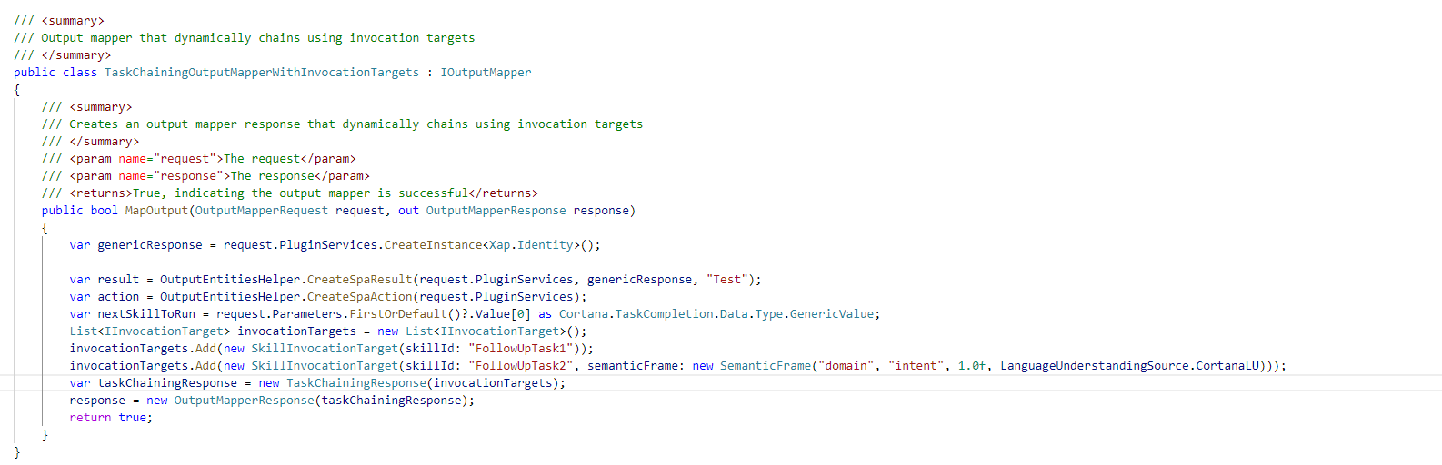

Slide 21
Notes:
ObservationUnderstanding - Analyzes the observation. Calls QAS to get the LU result i.e. semantic frames and its associated confidence scores.
SkillDiscovery - Generates potential skill candidates based on the observation and matches the trigger conditions in the skill.
Pre ranker - Further narrow down the skill candidate list based on rules, eg: Ignore skills if the turn type isn't primary
SkillRuntime - Based on the skill category - First party, third party, botframework skills, calls the appropriate skill executors and generates skill response. There is a concept of execution mode - ExecutionWithCommitment and ExecutionWithoutCommitment. PrePranker calls runtime with mode - ExecutionWithoutCommitment, which indicates to the SkillExecutor dont run transactional stuff in the skill/or dont run heavy tasks etc. Also it runs multiple skills and generates their response. Once ranker picks a skill, it calls runtime with mode - ExecutionWithCommitment, which indicates to skill executor to actually run the skill.
Ranker - Gets the skill candidates, ranks it(machine learning model is involved) and picks the one skill.
InteractionContinuation - Decides if we should continue conversation and generates the response that needs to send to client.
Runtime is an event driven system, so each of this components is called when an event is generated as a part of processing the observation sent to runtime.
If the request is coming from bing.com/search ABFPR XAP workflow is called. This workflow internally calls cortex aka cortana runtime platform. Response from runtime is sent to XAP which ranks Bing answers and Cortana skill and sends the response to user.

Slide 22
ObservationUnderstanding - Analyzes the observation. Calls QAS to get the LU result i.e. semantic frames and its associated confidence scores.
SkillDiscovery - Generates potential skill candidates based on the observation and matches the trigger conditions in the skill.
Pre ranker - Further narrow down the skill candidate list based on rules, eg: Ignore skills if the turn type isn't primary, or LU score is relatively low for the semantic frame
SkillRuntime - Based on the skill category - First party, third party, botframework skills, calls the appropriate skill executors and generates skill response. There is a concept of execution mode – ExecutionWithCommitment(Skill consultation) and ExecutionWithoutCommitment. PrePranker calls runtime with mode - ExecutionWithoutCommitment, which indicates to the SkillExecutor dont run transactional stuff in the skill/or dont run heavy tasks etc. Also it runs multiple skills and generates their response. Once ranker picks a skill, it calls runtime with mode - ExecutionWithCommitment, which indicates to skill executor to actually run the skill.
Ranker - Gets the skill candidates, ranks it(machine learning model is involved) and picks the one skill.
InteractionContinuation - Decides if we should continue conversation and generates the response that needs to send to client.
Runtime is an event driven system, so each of this components is called when an event is generated as a part of processing the observation sent to runtime.
If the request is coming from bing.com/search ABFPR XAP workflow is called. This workflow internally calls cortex aka cortana runtime platform. Response from runtime is sent to XAP which ranks Bing answers and Cortana skill and sends the response to user.

Slide 23
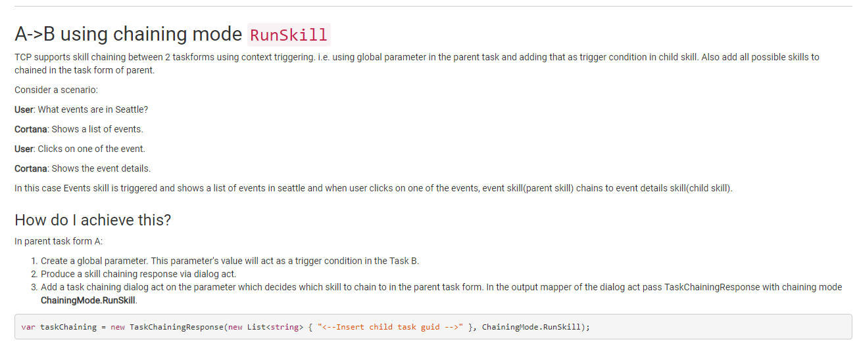

Slide 24
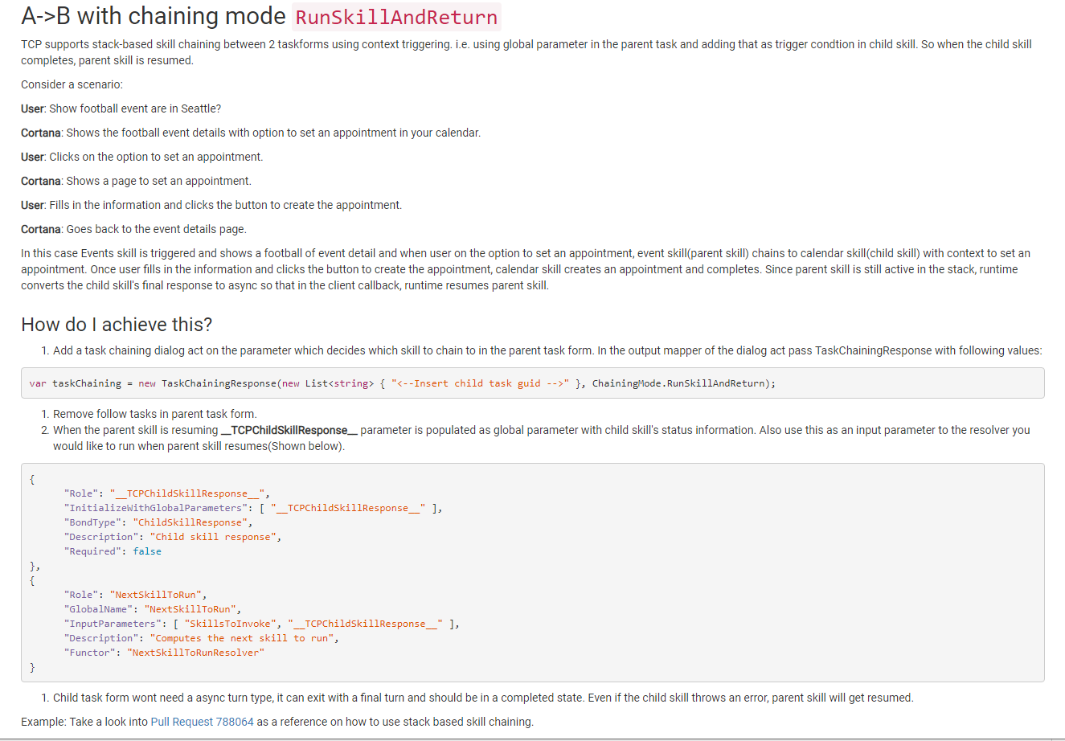

Slide 25
Is the order of execution of task forms deterministic based on DAG before resolution of parameters start? Eg: if the trigger condition for multiple task forms becomes true at the same time(which in itself is a bad design), in what order do they execute?
In chaining parent can define multiple skills as follow up tasks. And when the parent skill execution completes, a skill discovery event is triggered to find which skill should be triggered next. There can be scenarios where multiple child skill are discovered and executed. Even if there are multiple tasks triggered, ranker ultimately pick 1 winner skill.
Does all parameters of one task form resolve before moving on to the next task form in chain or can parameters across task forms execute in parallel if they are not dependent on each other?
Chaining happens sequentially. So parent skill will get executed i.e. parameters are resolved before we start executing child skill. Can you explain why there is a need to execute tasks forms in parallel?
What is the behavior if there can be more than 1 way to FinalTurn/TCPFinalAction from different task forms at the same time?
If you are asking if there are different ways to chain to another skill apart from adding FinalAction, then yes. It is possible to do so.
You can find more information on https://cortanawiki.azurewebsites.net/teams/core/skills/1PSkillGuide/SkillChaining.html?q=chaining

Slide 26
Disambiguation
Reaz Uddin
Can you please explain how disambiguation works, how control returns to our code, and the selection model?
Since a disambiguation can be resolved using a position or name(eg: person name or meeting title), is Core’s model smart enough to figure this out always rather than skill giving hints using “LUConstraints”?
Since a disambiguation can be for a parameter which is a struct (eg: Attendee has BondType as “ContactItem” which is a struct), how does Core figure out which property of the struct should be matched against for disambiguation?

Slide 27
Disambiguation
Reaz Uddin
How disambiguation works?
Starts when a parameter has multiple possible values
The resolver found multiple possible values for a parameter
Platform marks the parameter state as PromptedForSelection
Prompts the user using the DialogAct specified in the TaskForm
Comes back to Cortex with user utterance and runs the Selection pipeline
If one item is selected the parameter is marked Filled by the runtime.
Otherwise the platform reprompts with the selected items or all items if none selected.

Slide 28
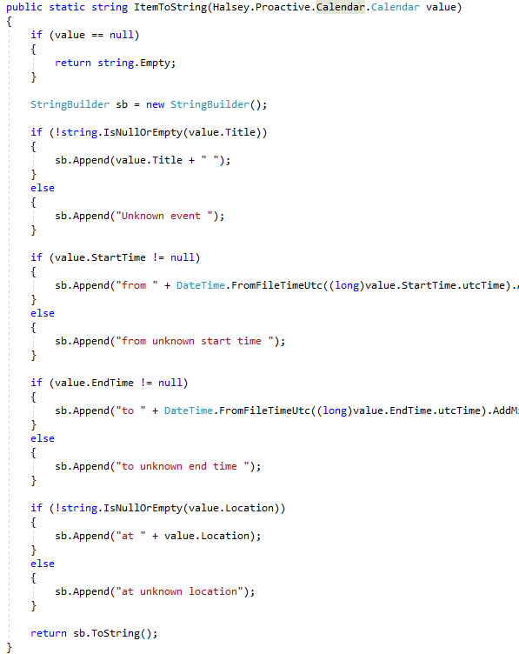
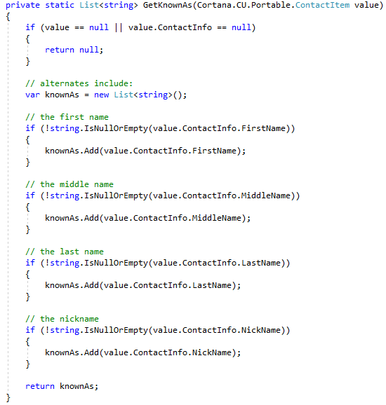
Disambiguation
Reaz Uddin
Which properties are used for disambiguation?
Cortex creates DialogEntity from the TCP entities, e.g., ContactItem, Calendar etc.
Following fields in DialogEntity need to be populated
DisplayText (DisplayHelper)
KnownAs[] (SetSelectionFieldsHelper)
If a new entity type is introduced, new methods need to be added

Slide 29
Disambiguation
Reaz Uddin
Select by position or name
To select by position ‘position_ref’ slot is needed
Usually the slot is generated by the skill LU
Selection pipeline was updated recently to generate this slot when no LU slot is generated
Being tested under SelectionSignals flight
To select by name, the user query should have some match with DisplayText or some KnownAs field.

Slide 30
Disambiguation
Reaz Uddin
Selection pipeline and model
Pre-Selection step checks if model execution can be avoided
Feature extraction from Query and Candidates.
A number of decision trees are evaluated to classify each candidate.
Update hypothesis with selected items.
Wiki page – Disambiguation Requirements
Aether pipelines
Data collection - aether://experiments/9951bedb-3024-4e05-9245-bce8c0bd106e
Training and Evaluation - aether://experiments/a926d298-7dfa-470f-bb66-d40ee87a419c
Instrumentation data goes to COSMOS.
UHRS Hit App
DialogHypothesis (contains SF and parameters with children)
PreSelectionProcessor
EvidenceGenerator
StatisticalProcessor
Updated DialogHypothesis (parameters with selected entities)
Status
HypothesisUpdater

Slide 31
Polite Refusal
Dmitriy Chernyak
What’s the correct way of implementing this for unsupported task forms? (Unsupported intent, for instance)
What’s the correct way of implementing this based on slot value validation? (Unsupported parameter value, such as ‘what do I have next year?’)

Slide 32



Polite Refusal
Dmitriy Chernyak
Used when a particular skill is supported on some devices and not on other devices.
Cortana will reply with a polite message.
Open Bing.com
Sorry, I can't open websites here

Slide 33
Polite Refusal
Dmitriy Chernyak
Polite Refusal for skills is handled centrally by the Fallback skill.
This makes it easier to bring up new devices and configure polite refusal for them.
Skills are usually defined by an intent, but occasionally by a combination of intent and slots.
For example, the query "Open Alexa" is handled by the open app intent and the alexa slot.
Dialog states that are similar to polite refusal but part of a skill should be handled within a skill.

Slide 34
Polite Refusal
Dmitriy Chernyak
Most of the time, surfaces follow an "Opt out" model, where as many skills as possible are enabled.
Sometimes (e.g. Outlook Commute) follows an "Opt in" model where most skills are disabled. All other intents run a Polite Refusal skill owned by Outlook Commute.
If you want to move a device to the "Opt in" model, talk to Core Runtime team.

Slide 35
Questions?

